Slide 1
Online Booking System
Recommend for Public Speaking Events

Slide 2
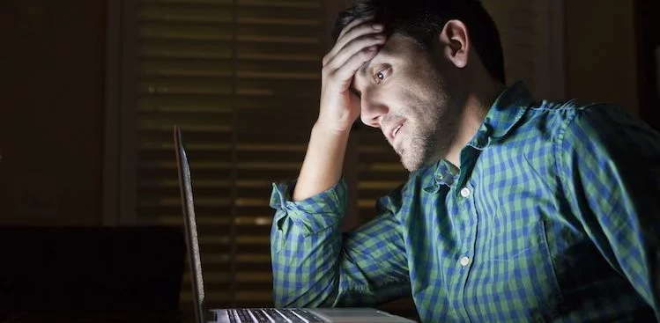
tired and confused planning for the upcoming public speaking event?

Slide 3

Way too busy to plan it yourself?

Slide 4

Then, you ,my friend, have come to the right place!

Slide 5
What our program does
We wrote a program to make it easier for people like you
By using our program, you can make your own seating plans without breaking a sweat!
Thanks to the online booking system, we made it convenient for people to just simply choose the seats they want to sit
No more wasted seats
No more people standing at the back of the room due to insufficient seats
No more wasting your time and energy on making the plans yourself!

Slide 6

Public speaking event
Public Speaking Event is really important and making it a convenient one for both the speakers and the listeners is a must! To make it a convenient one you must be accurate in everything!

Slide 7
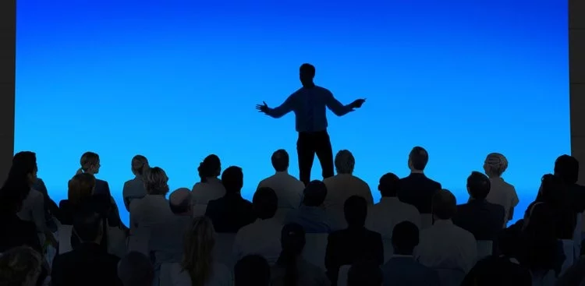
Insufficient seats
Not having enough seats or having too many seats and too little people can ruin a good public speaking event!

Slide 8
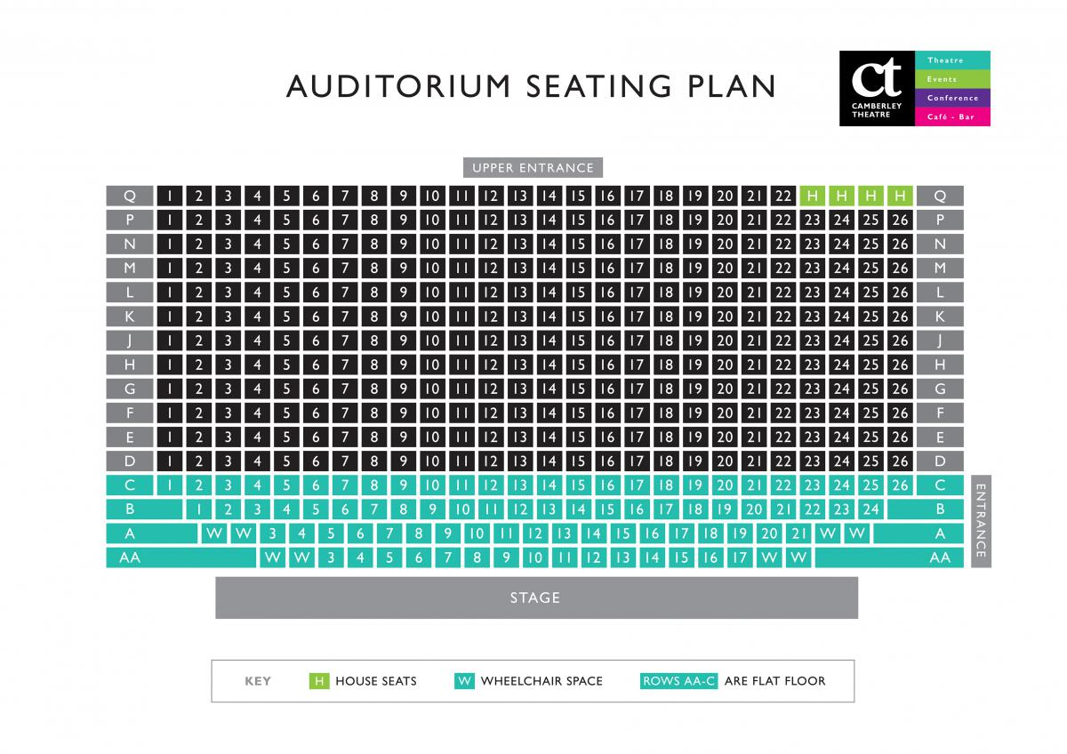
Seating plan
By using our program, you can make your own seating plans within only 10 minutes’ time.

Slide 9
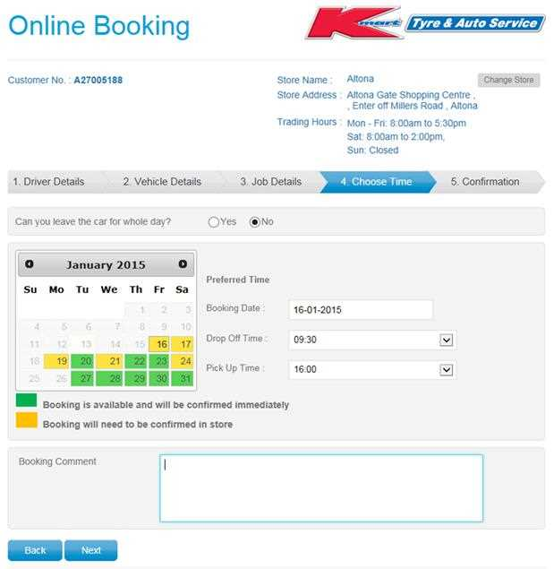
Online booking
Thanks to our online booking system, the listeners can conveniently book seats. In addition, you can also see how many seats have been taken and make any adjustment that you wnat.!

Slide 10
What’s more?
Our program is free for all
We don’t ask for your personal information
We don’t charge you for using our program
If you want to support our work, you can just simply subscribe our official page via facebook or YouTube!
By sharing our program to your colleagues and friends , you will be making their lives become as easy as yours!

Slide 11
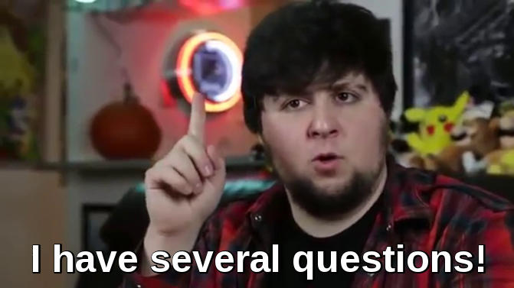
Please feel free to ask us any questions you want!

Slide 12
For further details :
Please visit our official website at www.OBSP.com

Slide 13
Thank you so much for giving us your time!!!

